Slide 1
Product adaptation

Slide 2
Standardization
Standardization : the same marketing strategy and mix in all the company’s international markets
More common for industrial goods
Consumer goods : cultural convergence. Regional differences and cultural specification integrated into one global product.
Pros : greater sales volume, lower production costs, greater profitability, integrated image worldwide

Slide 3
Adaptation
Adaptation : adjusting the marketing strategy and mix to each international target market
Business is a different game with different rules in each country
A product especially designed for a market can give a competitive edge over competitors

Slide 4
Main factors favouring standardization versus adaptation | Factors favoring Standardization | Factors favoring adaptation
Environment | Economies of scale in R&D, production and marketing (experience curve effects) | Local environment-induced adaptation: government and regulatory influences (no experience curve effects)
Competition | Global competition | Local competition
Consumer needs | Convergence of tastes and consumer needs (consumer preferences are homogeneous) | Variation in consumer needs (consumer needs are heterogeneous)
Management | Centralized management of international operations | Fragmented and decentralized management with dependent country subsidiaries
Competitors | A standardized concept is used by competitors | An adapted concept is used by competitors

Slide 5
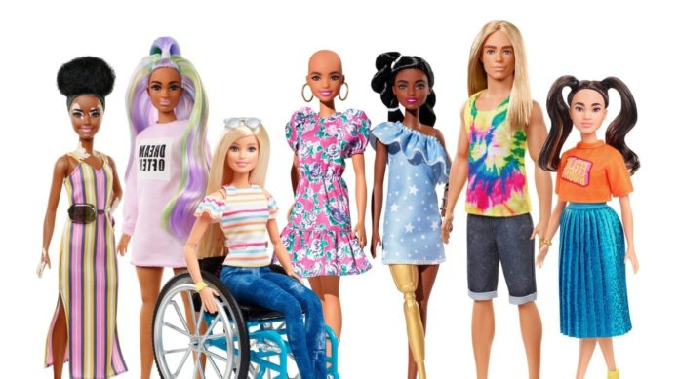
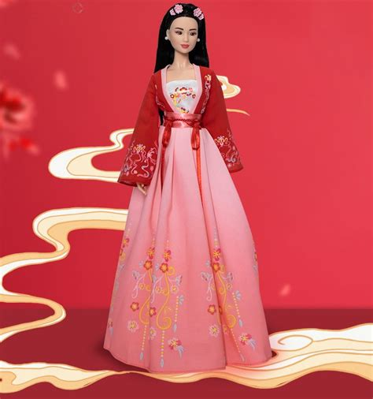
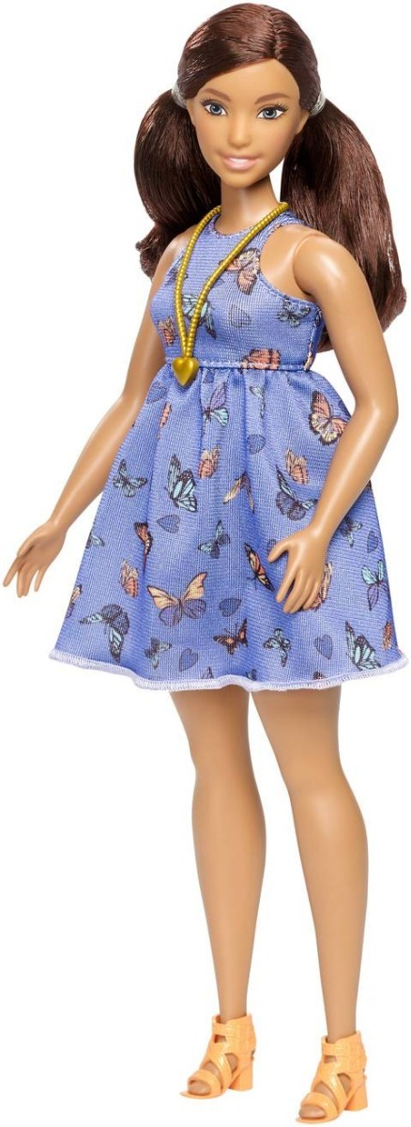
Adaptation TO ETHNICITY AND INCLUSIVITY: BARBIE DOLLS
Falling sales in the 2010s. Failure to enter the Indian market in 1997. Issue: uniform beauty standard (same mould (thin, tall, sexy), even when skin colour varies).
Project Dawn in 2016— seven skin tones, 24 hairstyles, 22 eye colours and three new body shapes (curvy, tall and petite)
Barbie's sales went up by 7 % : the top-selling toy: a curvy Latina doll. Over half of Barbie's dolls sold are not from its original range.
2025 : fewer product launch and tariffs causes sales to drop.

Slide 6
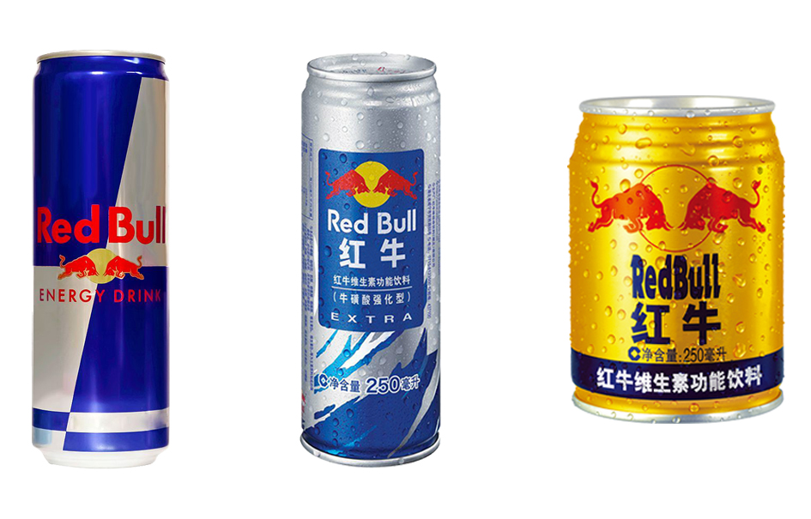
Product : repackaging

Slide 7
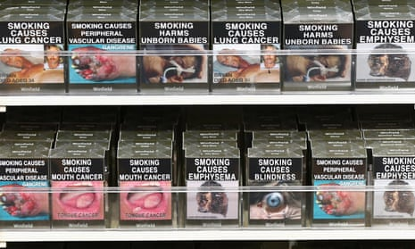
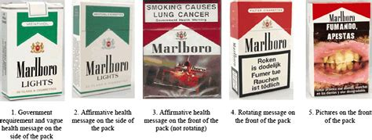
Labeling regulations
tobacco companies :
Plain packaging accelerating globally ( in 21 countries)
Graphic health warnings (in 134 countries)
in Canada, graphic health warnings must cover 75% of the front and back of the packaging, which is not yet the case in the US.

Slide 8
Pricing standardization : less price sensitive B2B market adaptation : B2C market/consumers’ revenues/local conditions/target.

Slide 9
Promotion/Advertising message
Standardization : advertising message effective worldwide. Minimum costs.
Adaptation : translation into the local language/religious and legal contexts
Ex : success of McDonald’s 2003 global campaign « I’m loving it ».
Yet is it the right translation in Chinese?
McDonald’s Chinese slogan translates “I’m lovin’ it” to 我就喜欢 (wo jiu xihuan). “I like it no matter what you say!”
positive alternatives would be “我很喜欢” (wo hen xihuan) or “我好喜欢” (wo hao xihuan), both of which mean “I really like it.”

Slide 10
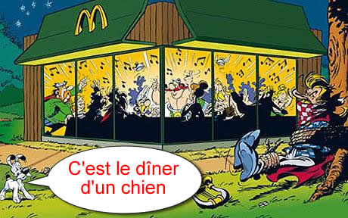
Wrong adaptation : Mc Donald’s France in 2010 caused an uproar (see this vandalised version of the ad)
Notes:
This caused an uproar because Asterix also embodies the French rebellious spirit as opposed to US imperialism. See the caption that was added in the vandalised version of the billboard.

Slide 11
Distribution channels
Can be more easily adapted
Depends on products, consumer targets (mass market/niche market) and national regulations
Omni channel approach for many brands:
Ex. Nike combines DTC (Direct to Customer) and indirect sales through distributors. Increased use of e-commerce via marketplaces and on its own website.

Slide 12
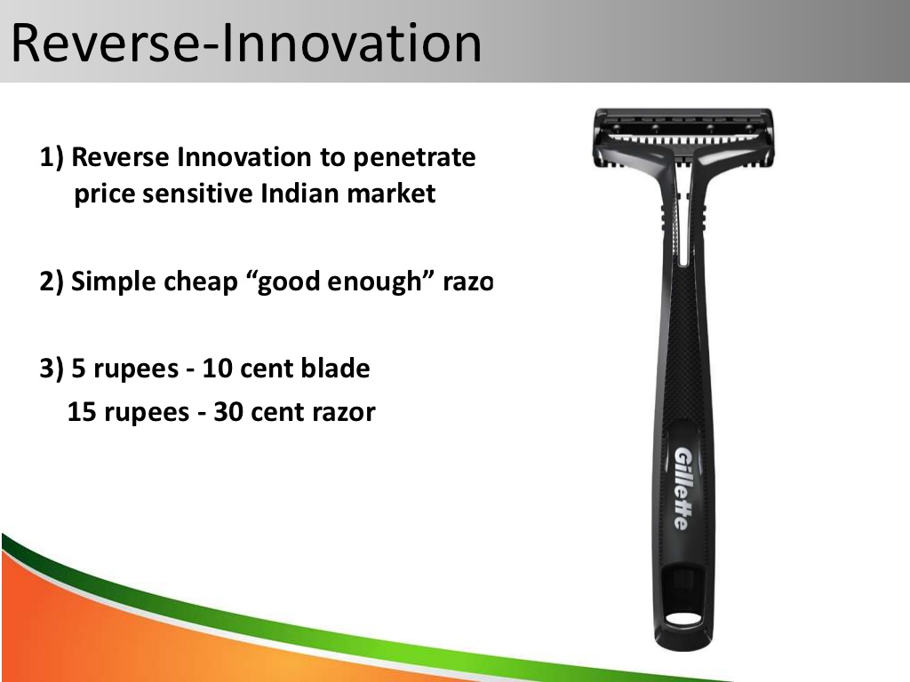
Gillette and adaptation https://www.businesstoday.in/magazine/lbs-case-study/gillette-innovated-improved-its-market-share-in-india/story/204517.html
2003: Failure to sell lower and mid-tier American razors in different packaging.
2010 : success of "reverse innovation" to develop a product for the lower income customer.
Local manufacturing enabled Gillette to lower its cost structure and maintain low prices.
new distribution model, based on millions of local shops called kiranas.
2025 : Aggressive promotion campaign.
The Guard model was refined with a water-saving design. Launch of dual-purpose razor and trimmer, catering to rural men's growing interest in facial hair trends.
Series Gel 2025, a low-cost shaving gel priced at ₹2 per use. Formulated for Indian skin types and designed to work with minimal water, it addresses rural consumers' practical needs.
https://www.ainvest.com/news/gillette-india-grooming-segment-strategic-growth-engine-challenging-market-2507/

